Slide 1
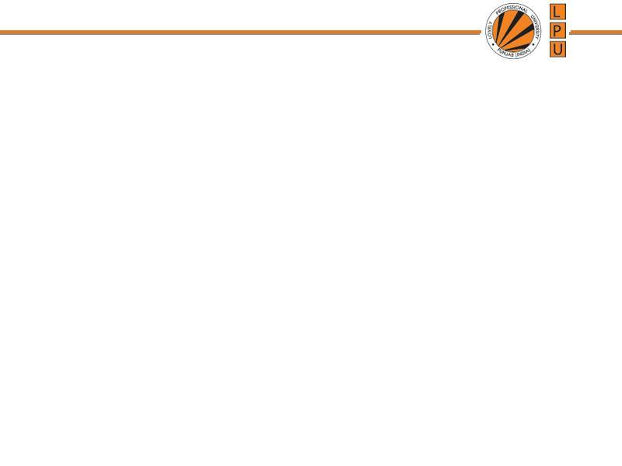
Chapter : Process Synchronization

Slide 2
Background
Co-Operating Process: that can affect or be affected by other processes executing in system
Concurrent access to shared data may result in data inconsistency
Process Synchronization: Ensures coordination among processes and maintains Data Consistency
Process P1 Process P2
1. X=5
2. X=5+2
1. read(x);
2. x=x+5;
3. Printf( x);

Slide 3
Producer Consumer Problem
There can be two situations:
1. Producer Produces Items at Fastest Rate Than Consumer Consumes
2. Producer Produces Items at Lowest Rate Than Consumer Consumes

Slide 4
Producer Consumer Problem
Producer Produces Items at Fastest Rate Than Consumer Consumes:
If Producer produces items at fastest rate than Consumer consumes Then Some items will be lost
Eg. Computer → Producer
Printer → Consumer

Slide 5
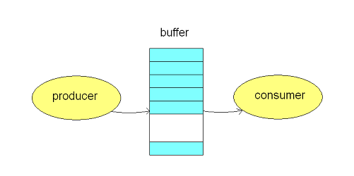
Producer Consumer Problem
Solution:
To avoid mismatch of items Produced or Consumed → Take Buffer
Idea is: Instead of sending items from Producer to Consumer directly→ Store items into buffer

Slide 6
Producer Consumer Problem
Buffer Can be:
1. Unbounderd Buffer:
  No buffer size limit
  Any no. of items can be stored
  Producer can produce on any rate, there will always be space in buffer
2. Bounded Buffer:
  Limited buffer size

Slide 7
Producer Consumer Problem
Bounderd Buffer:
If rate of Production > rate of Consumption:
Some items will be unconsumed in buffer
If rate of Production < rate of Consumption:
At some time buffer will be empty

Slide 8
Producer
while (true) {
/* produce an item and put in nextProduced */
while (count == BUFFER_SIZE)
; // do nothing
buffer [in] = nextProduced;
in = (in + 1) % BUFFER_SIZE;
count++;
}

Slide 9
Consumer
while (true) {
while (count == 0) // buffer empty
{
; // do nothing
}
nextConsumed = buffer[out];
out = (out + 1) % BUFFER_SIZE;
count- -;
/* consume the item in nextConsumed
}

Slide 10
Race Condition
When multiple processes access and manipulate the same data at the same time, they may enter into a race condition.
Race Condition: When output of the process is dependent on the sequence of other processes.
Race Condition occurs when processes share same data
Process P1 Process P2
1. reads i=10
2. i=i+1 =11
1. P2 reads i=11 from memory 2. i=i+1 = 12
3. Stores i=11 in memory 3. Stores 12 in memory

Slide 11
Critical Section Problem
Section of code or set of operations, in which process may be changing shared variables, updating common data.
A process is in the critical section if it executes code that manipulate shared data and resources.
Each process should seek permission to enter its critical section→ Entry Section
Exit Section
Remainder section: Contains remaining code

Slide 12
Structure of a process
Locks are set here
Critical Section ( a section of code where processes work with shared data)
Locks are released here
Repeat
{
// Entry Section
Critical Section
// Exit Section
Remainder Section
} until false.

Slide 13
Solution to: Critical Section
1. Mutual Exclusion:
It states that if one process is executing in its critical section, then no other process can execute in its critical section.
2. Bounded Wait:
It states that if a process makes a request to enter its critical section and before that request is granted, there is a limit on number of times other processes are allowed to enter that critical section.
3. Progress:
It states that process cannot stop other process from entering their critical sections, if it is not executing in its CS.

Slide 14
Peterson’s Solution
Two process solution (Software-based)
The two processes share two variables:
  int turn;
  Boolean flag[2]
The variable turn indicates whose turn it is to enter the critical section.
The flag array is used to indicate if a process is ready to enter the critical section. flag[i]=true implies that process P_{i} is ready!

Slide 15
Only 2 processes,
General structure of process P_{i} (other process P_{j})
do {
entry section
critical section
exit section
reminder section
} while (1);

Slide 16
Algorithm for Process P_{i}
do {
flag[i] = TRUE;
turn = j;
while ( flag[j] && turn == j);
CRITICAL SECTION
flag[i] = FALSE;
REMAINDER SECTION
} while (TRUE);

Slide 17
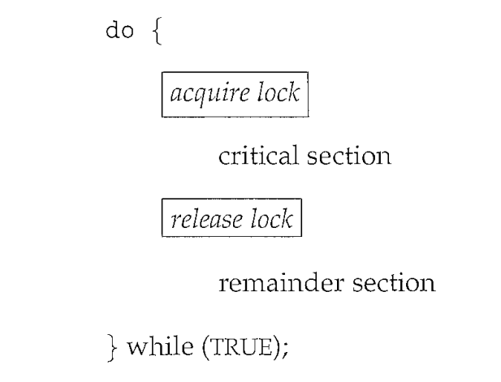

Slide 18
Critical Section Problem solution
Now prove that this solution is correct. We need to show that:
  Mutual exclusion is preserved.
  The progress requirement is satisfied.
  The bounded-waiting requirement is met.

Slide 19
Synchronization Hardware
Hardware Solution to C.S.
Many systems provide hardware support for critical section code
Uni-processors – could disable interrupts
  Currently running code would execute without preemption
Modern machines provide special atomic hardware instructions
    Atomic = non-interruptable
  Either test memory word and set value
  Or swap contents of two memory words

Slide 20
Hardware Solution to C.S.
1. Interrupt Disabling
Process leaves control of CPU when it is interrupted.
Solution is:
  To have each process disable all interrupts just after entering to the critical section.
  Re-enable interrupts after leaving critical section

Slide 21
Hardware Solution to C.S.
Interrupt Disabling
Repeat
Disable interrupts
C.S
Enable interrupts
Remainder section

Slide 22
Synchronization Hardware
Having the support of some simple hardware instructions, the CS problem can be solved very easily and efficiently.
The CS problem occurs because the modification of a shared variable of a process may be interrupted.
Two common hardware instructions that execute atomically
  Test-and-Set
  Swap

Slide 23
Synchronization Hardware
Test and modify the content of a word atomically.
boolean TestAndSet(boolean &target) {
boolean rv = target;
target = true;
return rv;
}

Slide 24
Mutual Exclusion with Test-and-Set
Shared data:
boolean lock = false;
Process P_{i}
do {
while (TestAndSet(lock)) ;
critical section
lock = false;
remainder section
}

Slide 25
Synchronization Hardware
Atomically swap two variables.
void Swap(boolean &a, boolean &b) {
boolean temp = a;
a = b;
b = temp;
}

Slide 26
Mutual Exclusion with Swap
Shared data (initialized to false):
boolean lock; /*global variable
Process P_{i}
do {
key = true;
while (key == true)
Swap(lock, key);
critical section
lock = false;
remainder section
}

Slide 27
Semaphore
Synchronization tool that maintains concurrency using variables
Semaphore S is a integer variable which can take positive values including 0. It is accessed from 2 operations only.
Operations On Semaphore:
wait() and signal()
1. Wait Operation is also known as P() which means to test
2. Signal Operation is also known as V() which means to increment
Entry to C.S. is controlled by wait()
Exit from C.S. is signaled by signal()

Slide 28
Semaphore
Can only be accessed via two indivisible (atomic) operations and S=1
For critical Section problem semaphore value is always 1
P(S) and V(S):
  wait (S) {
  while (S <= 0)
  do skip ; // no-op}
  S- -;
  C.S
  signal (S) {
  S++; }

Slide 29
Semaphore as General Synchronization Tool
Types of Semaphores:
Counting semaphore – when integer value can be any non-negative value
Binary semaphore – integer value can range only between 0 and 1
  Also known as mutex locks

Slide 30
Semaphore and Busy Waiting
Disadvantage of Semaphore: Busy Waiting
When a process is in C.S. and any other process that wants to enter C.S. loops continuously in entry section.
Wastes CPU cycles
Semaphore that implements busy waiting is known as: Spin Lock

Slide 31
Semaphore Implementation with no Busy waiting
With each semaphore there is an associated waiting queue. Each entry in a waiting queue has two data items:
  value (of type integer)
  pointer to next record in the list

Slide 32
Semaphore Implementation with no Busy waiting
Instead of waiting, a process blocks itself.
Two operations:
  block – place the process invoking the operation on the waiting queue.
  wakeup – remove one of processes in the waiting queue and place it in the ready queue.

Slide 33
Semaphore Implementation with no Busy waiting
Implementation of wait:
S=1
wait (S){
value--;
if (value < 0) {
add process P to waiting queue
block();
}
      C.S
      }

Slide 34
Semaphore Implementation with no Busy waiting
Implementation of signal:
Signal (S){
value++; //“value” has -ve value i.e -1 here
if (value <= 0) {
remove a process P from the waiting queue
wakeup(P); }
}

Slide 35
Deadlocks and Starvation
The using of semaphores may cause deadlocks
Starvation – indefinite blocking. A process may never be removed from the semaphore queue in which it is suspended
  For example: waiting queues are implemented in LIFO order.
P₀
(Initially, A=B=1)
P₁
wait(B);
wait(A);
S₁
signal(B);
signal(A);
wait(A);
wait(B);
S₀
signal(A);
signal(B);
deadlock

Slide 36
Drawbacks of Semaphores
Semaphores provide a convenient and effective mechanism for process synchronization.
However, incorrect use may result in timing errors.
signal(mutex);
...
critical section
...
wait(mutex);
wait(mutex);
...
critical section
...
incorrect order
(not mutual exclusive)
forgotten
...
critical section
...
signal(mutex);
wait(mutex);
...
critical section
...
wait(mutex);
typing error
(deadlock)

Slide 37
Classical Problems of Synchronization
Bounded-Buffer Problem
Readers and Writers Problem
Dining-Philosophers Problem

Slide 38
Readers-Writers Problem
A data set is shared among a number of concurrent processes
  Readers – only read the data set; they do not perform any updates
  Writers – can both read and write.
Problem – allow multiple readers to read at the same time. Only one single writer can access the shared data at the same time.
Shared Data
  Data set
  For Readers: Semaphore mutex initialized to 1.
  For Writers: Semaphore wrt initialized to 1.
  Integer readcount initialized to 0.

Slide 39
Readers-Writers Problem (Cont.)
The structure of a writer process
while (true) {
wait (wrt) ;
// writing is performed
signal (wrt) ;
}

Slide 40
Readers-Writers Problem (Cont.)
The structure of a reader process
while (true) {
wait (mutex) ;
readcount ++ ;
if (readcount == 1)
wait (wrt) ; //( don’t allow writers)
signal (mutex); //(allow other readers to come)
// reading is performed
wait (mutex) ; // (one by one readers leave the C.S.)
readcount - - ;
if (readcount == 0)
{ signal (wrt) ; } // last reader will do this
signal (mutex) ; // mutex=1 (for readers to exit and writer to come)
}

Slide 41
reader
first-in
writer
wait(mutex);
readcount++;
if (readcount == 1) wait(wrt);
signal(mutex);
...
reading is performed
...
wait(mutex);
readcount--;
if (readcount == 0) signal(wrt);
signal(mutex);
wait(wrt);
...
writing is performed
...
signal(wrt);
update
readcount

Slide 42

Dining-Philosophers Problem
Five philosophers, either thinking or eating
to eat, two chopsticks are required
taking one chopstick at a time
Shared data
semaphore chopstick[5];
  Initially all values are 1
3
3
2
4
2
4
1
5
1
5

Slide 43
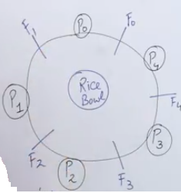
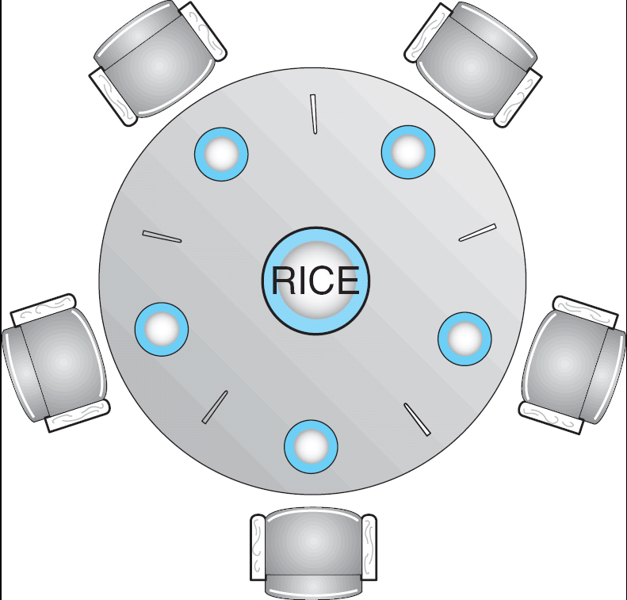
Dining-Philosophers Problem

Slide 44
Dining-Philosophers Problem
philosopher i
get chopsticks
left
right
do {
wait(chopstick[i]);
wait(chopstick[(i+1) % 5]);
...
eat
...
signal(chopstick[i]);
signal (chopstick[(i+1) % 5]);
...
think
...
} while(1);
free chopsticks
left
right
deadlock !

Slide 45
Dining-Philosophers Problem
Possible solutions to the deadlock problem
  Allow at most four philosophers to be sitting simultaneously at the table.
  Allow a philosopher to pick up her chopsticks only if both chopsticks are available (note that she must pick them up in a critical section).
  Use an asymmetric solution; that is,
    odd philosopher: left first, and then right
    an even philosopher: right first, and then left
Besides deadlock, any satisfactory solution to the DPP problem must avoid the problem of starvation.

Slide 46
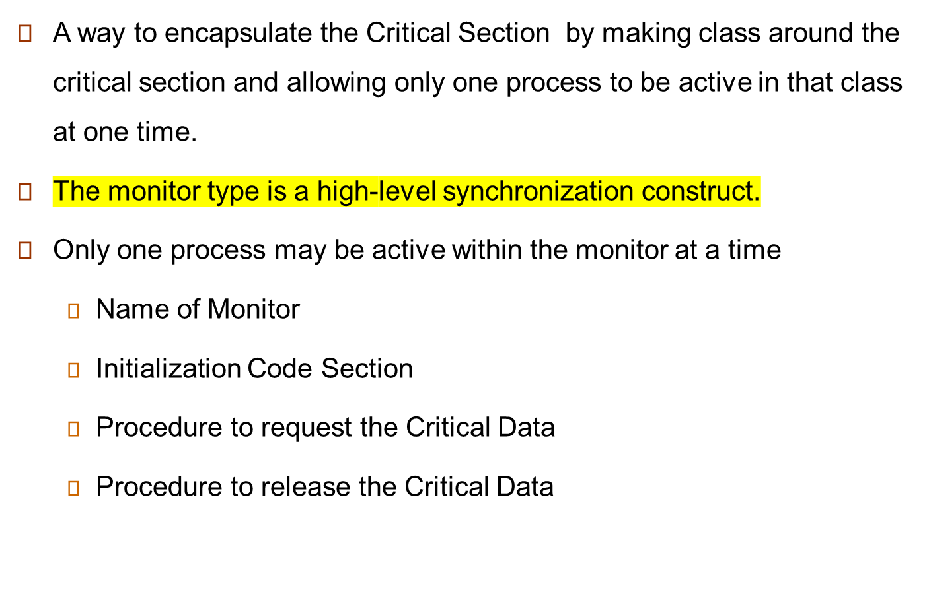
Monitors

Slide 47
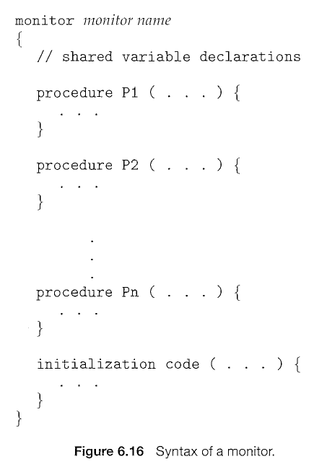

Slide 48

Schematic view of a Monitor
Only one process at a time can be in monitor

Slide 49
Monitors
The monitor construct is not sufficiently powerful for modeling some synchronization schemes.
So, we need to define additional synchronization mechanisms.
These mechanisms are provided by the condition construct.
A programmer can define one or more variables of type condition:
  condition x, y;
  The only operations that can be invoked on a condition variable are wait () and signal().

Slide 50
Condition Variables
Two operations on a condition variable:
  x.wait () – a process that invokes the operation is suspended until another
  process invokes x.signal()
  x.signal () – resumes one of processes (if any) that invoked x.wait ()
  There could be different conditions for which a process could be waiting

Slide 51

Monitor with Condition Variables

Slide 52
Solution to Dining Philosophers (cont)
The distribution of the chopsticks is controlled by the monitor DiningPhilosophers
Each philosopher ‘ i ’ invokes the operations pickup() and putdown() in the following sequence:
dp.pickup (i)
EAT
dp.putdown (i)

Slide 53
Solution to Dining Philosophers
monitor DP
{
enum { THINKING; HUNGRY, EATING) state [5] ;
condition self [5];
void pickup (int i) {
state[i] = HUNGRY;
test(i);
if (state[i] != EATING)
self [i].wait;
}
void putdown (int i) {
state[i] = THINKING;
// test left and right neighbors
test((i + 4) % 5);
test((i + 1) % 5);
}

Slide 54
Solution to Dining Philosophers (cont)
void test (int i) {
if ( (state[(i + 4) % 5] != EATING) && (state[i] == HUNGRY) &&
(state[(i + 1) % 5] != EATING) )
{
state[i] = EATING ;
self[i].signal() ;
}
}
initialization_code() {
for (int i = 1; i <= 5; i++)
state[i] = THINKING;
}
}

